Slide 1

Demystifying The Spectral Bias of Overparameterized Deep Neural Networks
Genglin Liu
University of Massachusetts, Amherst

Slide 2
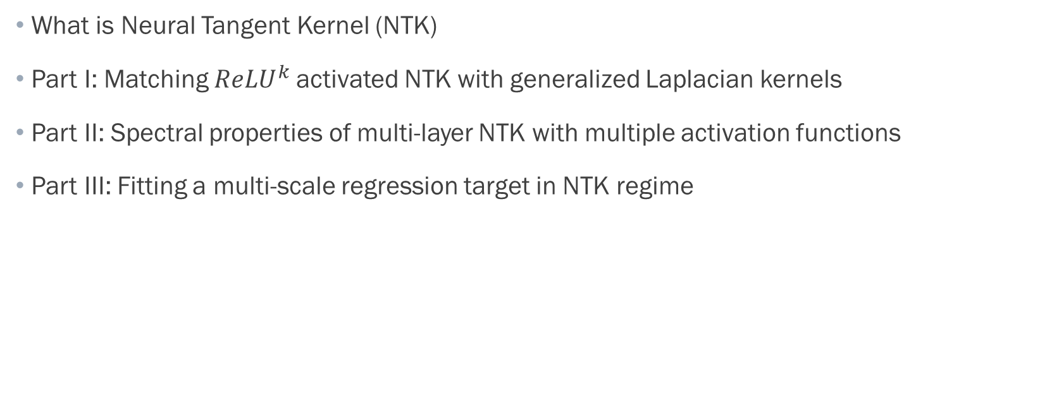
Outline
What is Neural Tangent Kernel (NTK)
Part I: Matching ${ReLU}^{k}$activated NTK with generalized Laplacian kernels
Part II: Spectral properties of multi-layer NTK with multiple activation functions
Part III: Fitting a multi-scale regression target in NTK regime

Slide 3
Overparametrized Neural Networks and Motivation of NTK
Ultra-side Neural Network training dynamics is similar to kernel regression with a special kernel called Neural Tangent Kernel (NTK)
Understanding convergence and generalization error of neural networks through NTK theory
Investigating the reproducing kernel Hilbert space (RKHS) associated to the NTK.
Studying the RKHS → Compute the spectral decay of the kernel

Slide 4
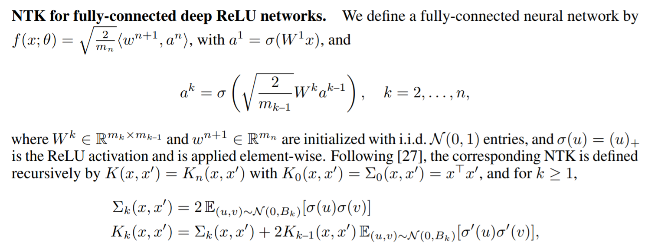
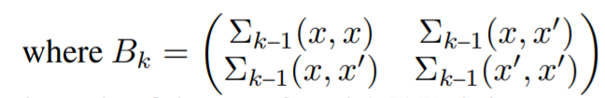
Recursive Definition of Neural Tangent Kernel
[1]

Slide 5
NTK Theory
Spectral bias of neural networks
MLPs correspond to kernels with a rapid frequency falloff, which effectively prevents them from being able to represent the high-frequency components in functions [2]
Analysis of the NTK’s eigen-decomposition supports this theory

Slide 6
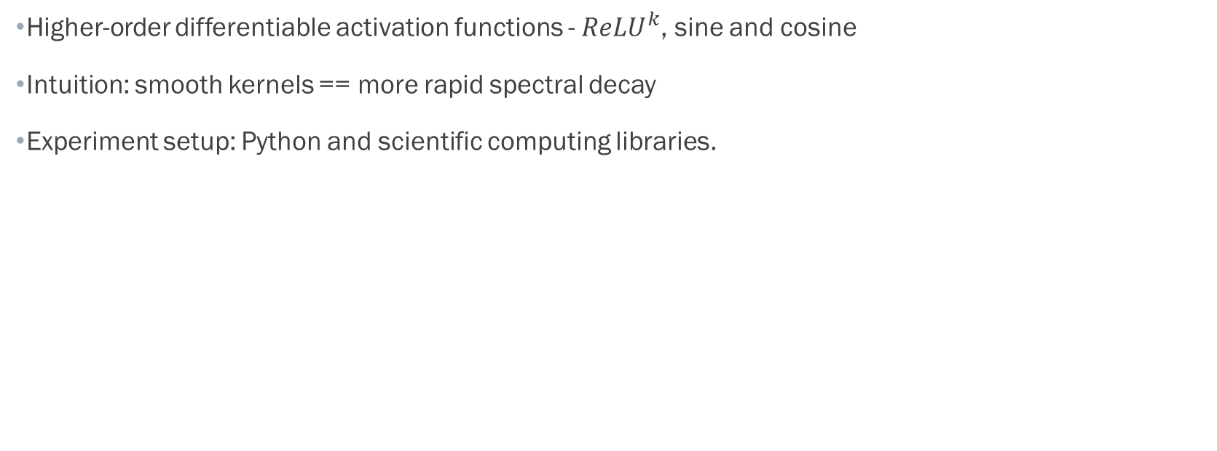
Activation Functions and Smoothness
Higher-order differentiable activation functions - ${ReLU}^{k}$, sine and cosine
Intuition: smooth kernels == more rapid spectral decay
Experiment setup: Python and scientific computing libraries.

Slide 7
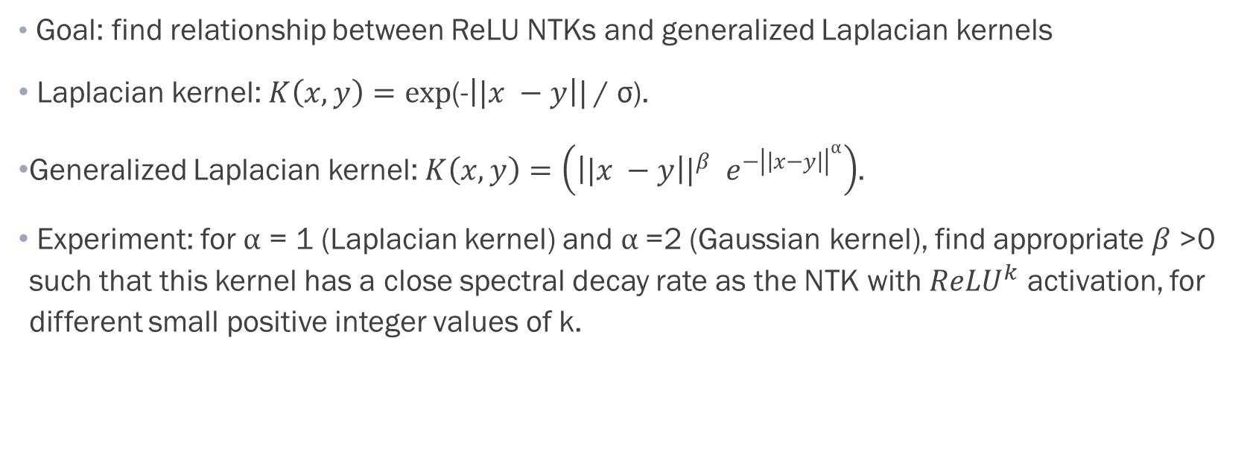
Part 1: Spectral Properties of Two-layer NTK
Goal: find relationship between ReLU NTKs and generalized Laplacian kernels
Laplacian kernel: $K\left(x, y\right)=exp\text{(-}\left||x −y\right|| \text{/ }\text{σ}\text{).}$
Generalized Laplacian kernel: $K\left(x, y\right)=\left({\left||x −y\right||}^{β} e^{−{\left|\left|x−y\right|\right|}^{α}}\right)$.
Experiment: for $α$ = 1 (Laplacian kernel) and $α$=2 (Gaussian kernel), find appropriate $β$>0 such that this kernel has a close spectral decay rate as the NTK with ${ReLU}^{k}$ activation, for different small positive integer values of k.

Slide 8
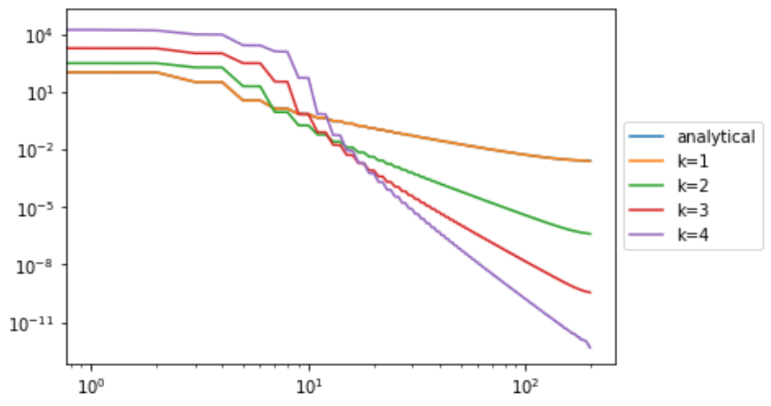
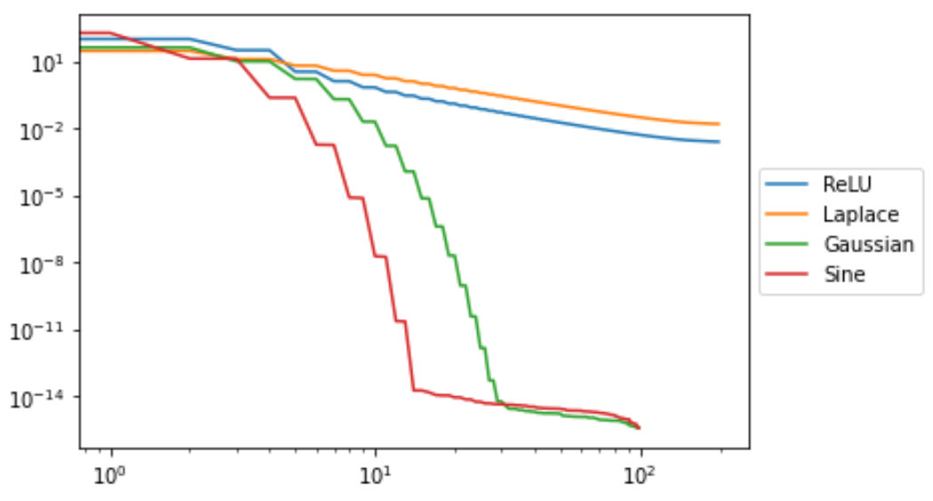
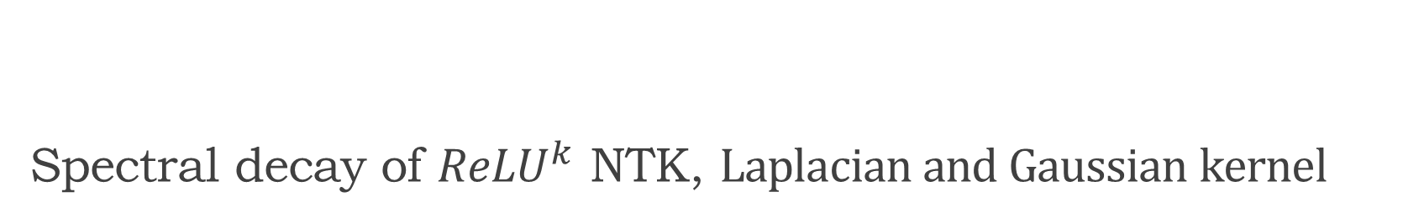
Spectral decay of ${ReLU}^{k}$ NTK, $Laplacian and Gaussian kernel$

Slide 9
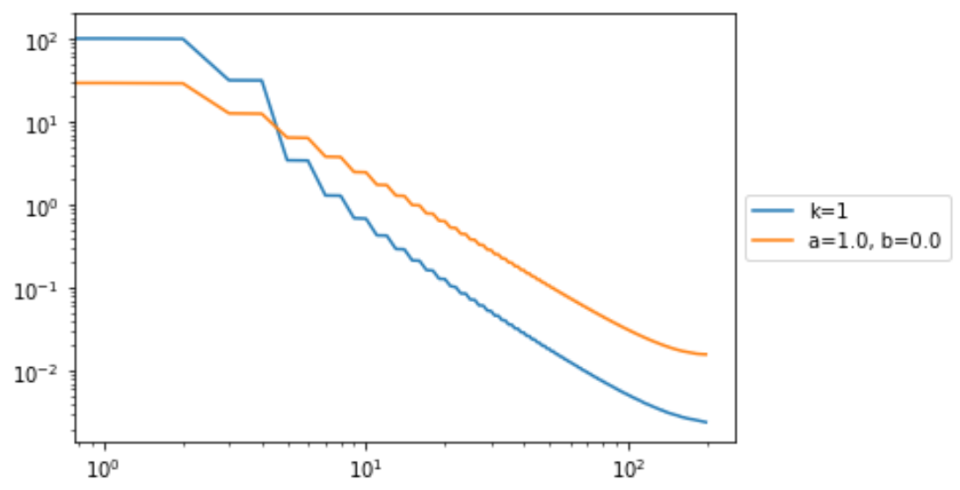
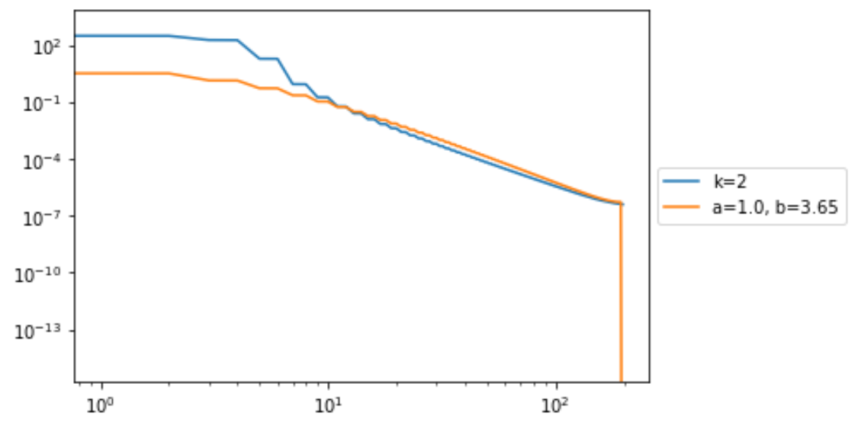
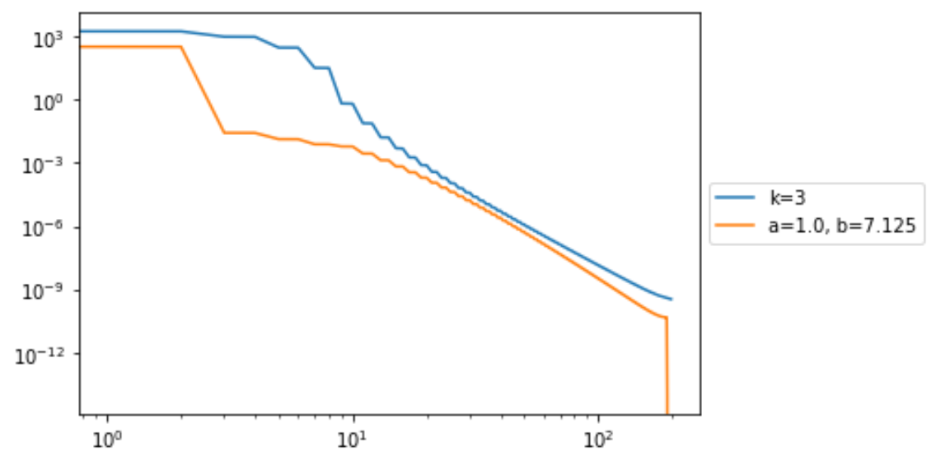
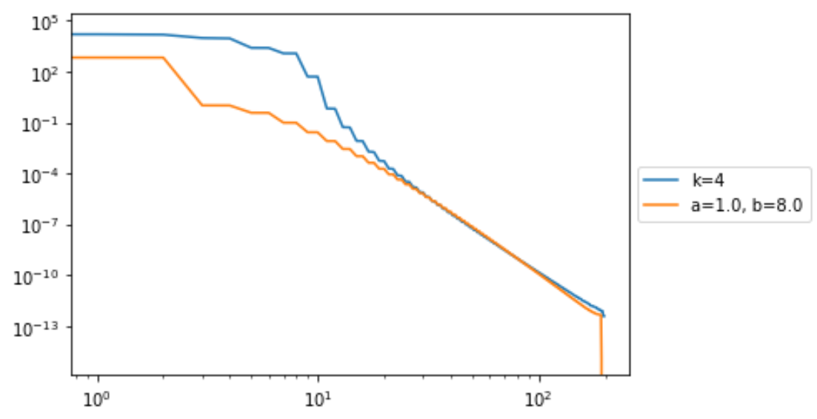
Tuned beta value in Laplacian for each k in ReLU NTK

Slide 10
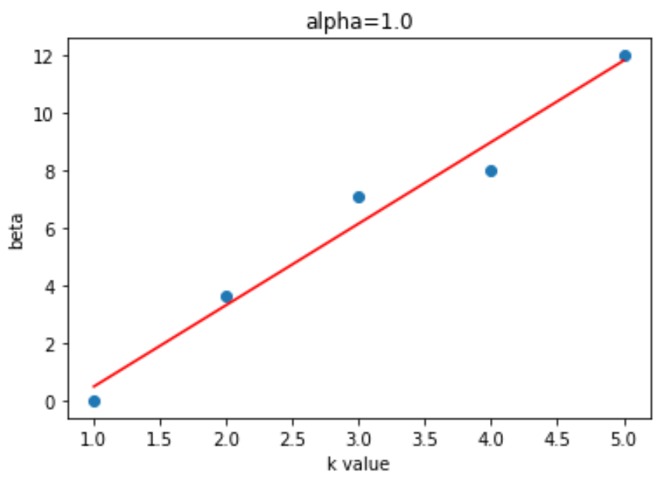
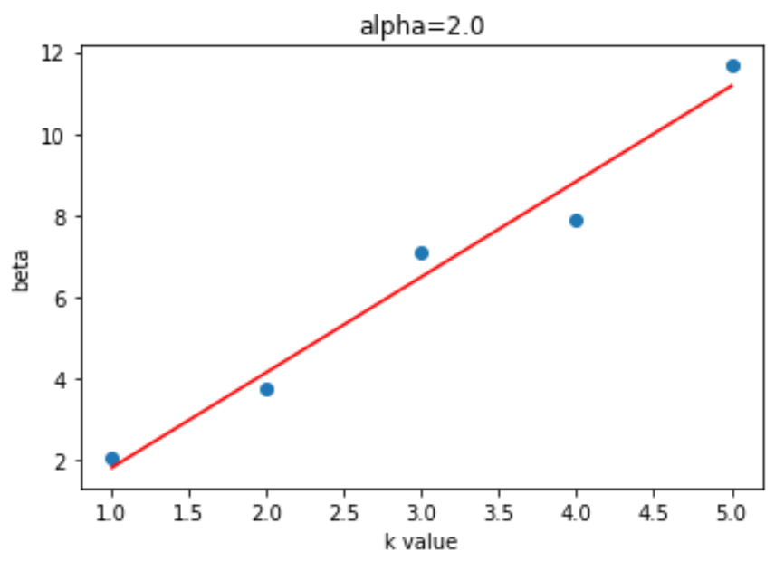
Linear relationship between beta vs k value, given fixed alpha

Slide 11
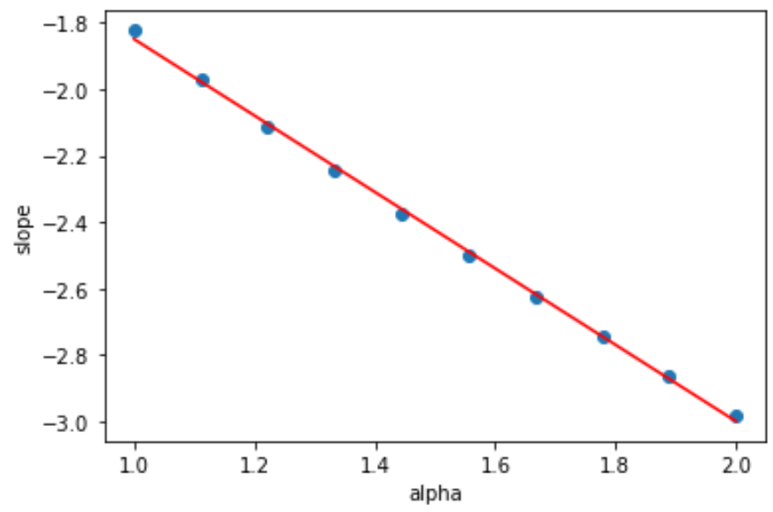
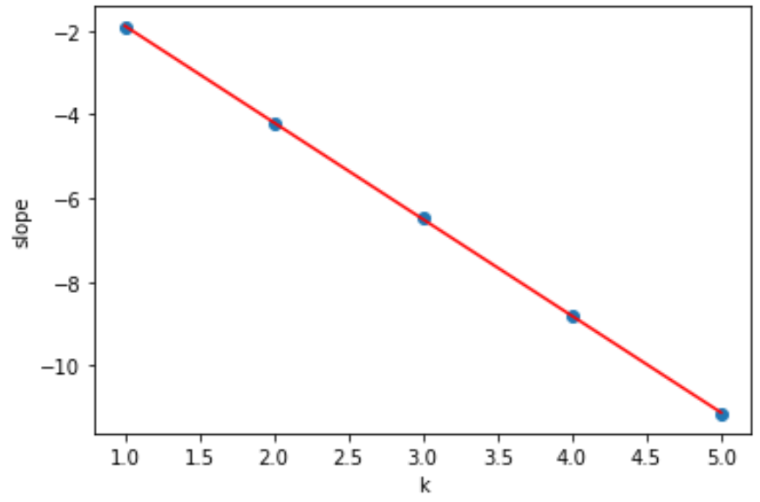
Linear relationship between alpha, k and decay rate, without beta

Slide 12
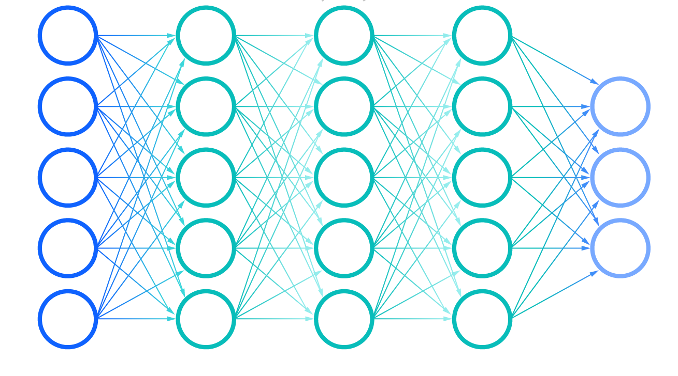
Part 2: Multi-layer NTK
Multiple activation functions
What happens when sine and ReLU are applied together in a neural network? [3]
Does the order of the activation placement matter?

Slide 13
Building the Multi-layer NTK
Two-layer NTK → Three-layer NTK
Univariate Gaussian sampling → multivariate sampling from a covariance matrix
Analytical solution for the ReLU network + numerical approximation to a network with a general nonlinear activation
Entry-wise and vectorized Implementation

Slide 14
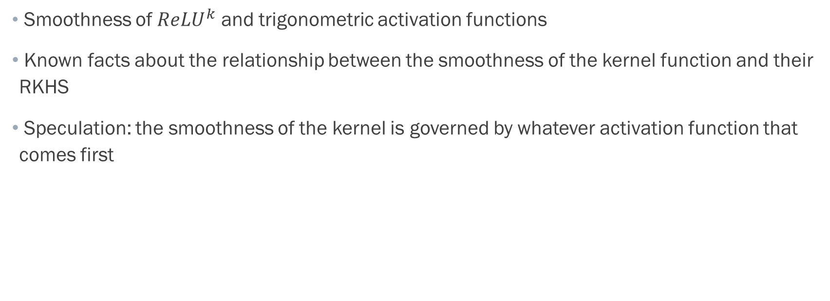
Kernel Smoothness and Spectral Decay
Smoothness of ${ReLU}^{k}$ and trigonometric activation functions
Known facts about the relationship between the smoothness of the kernel function and their RKHS
Speculation: the smoothness of the kernel is governed by whatever activation function that comes first

Slide 15
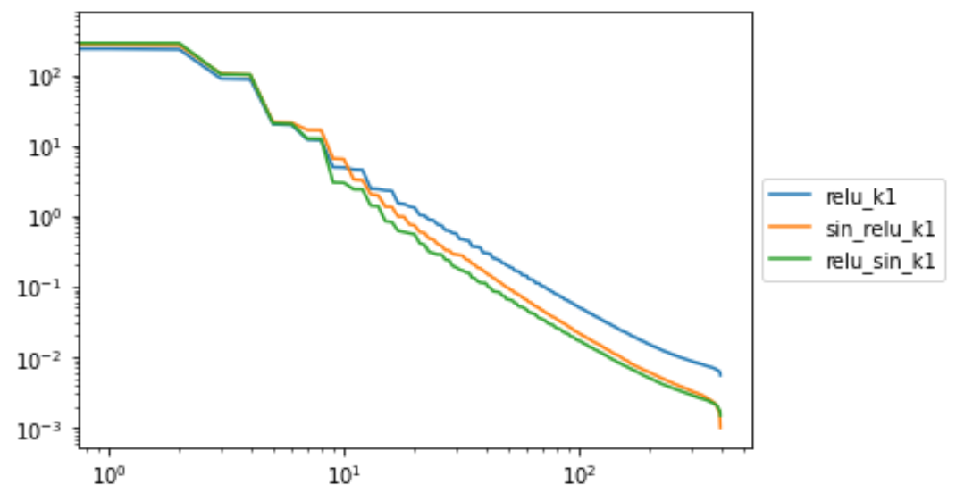
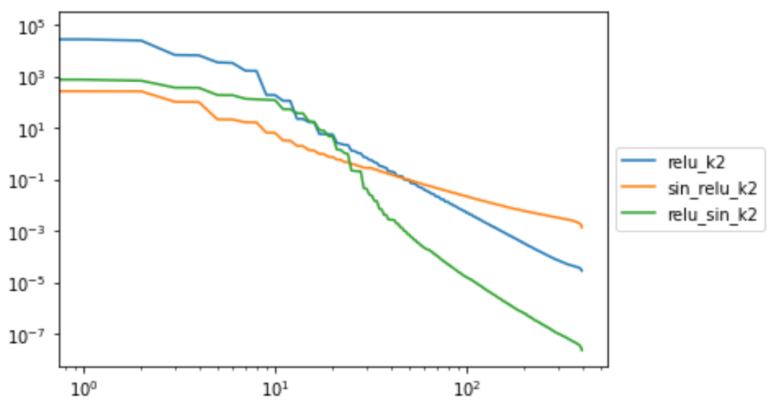
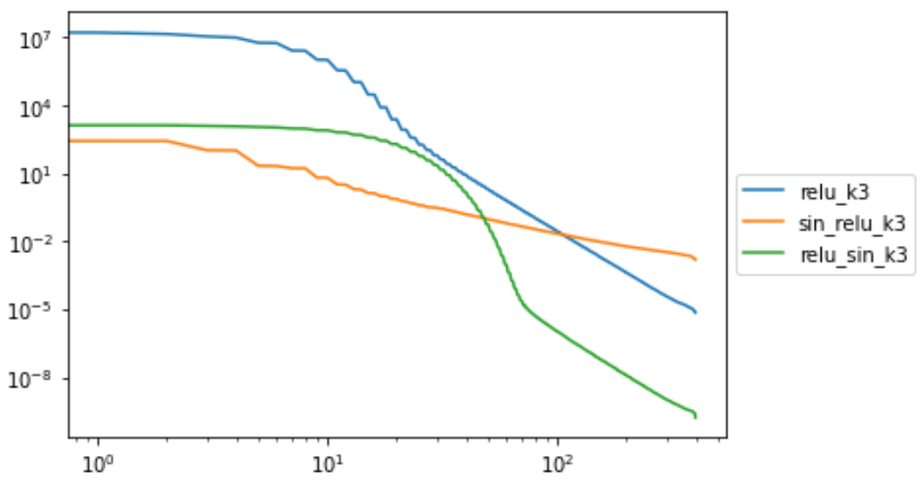
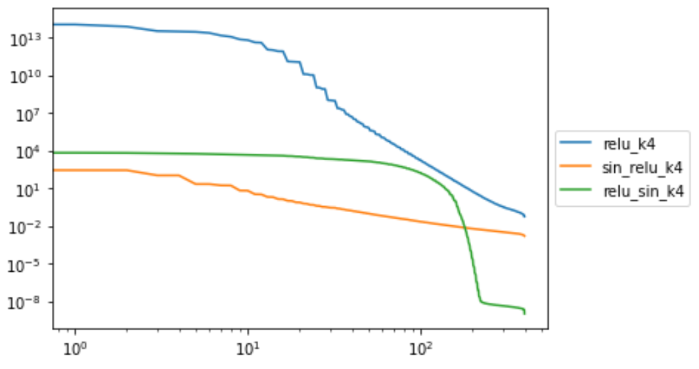
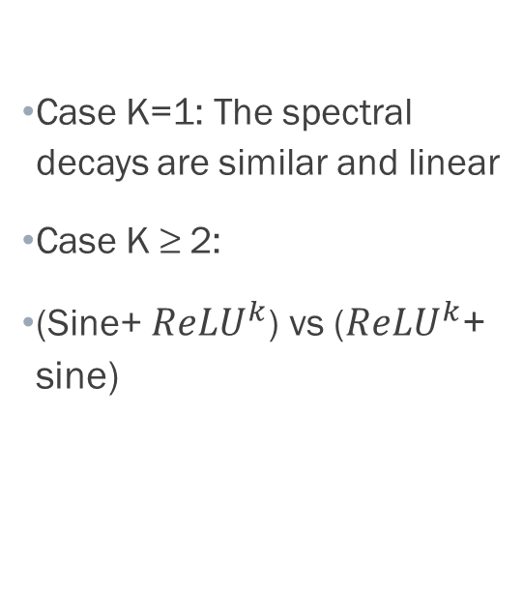
Numerical Observations
Case K=1: The spectral decays are similar and linear
Case K ≥ 2:
(Sine+ ${ReLU}^{k}$) vs (${ReLU}^{k}$+ sine)

Slide 16
Part III: Training in NTK regime
Fitting a regression curve to a multi-scale function
Difficulty with the presence of spectral bias [4]
Default uniform weight initialization vs training under in the neural tangent kernel regime?
Picking target functions to train on

Slide 17
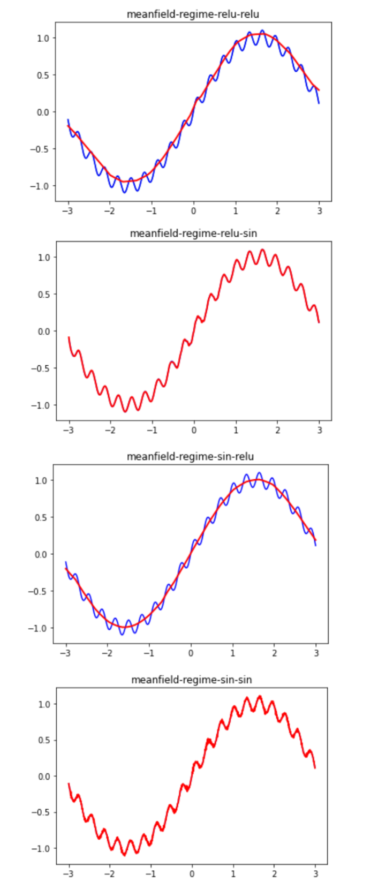
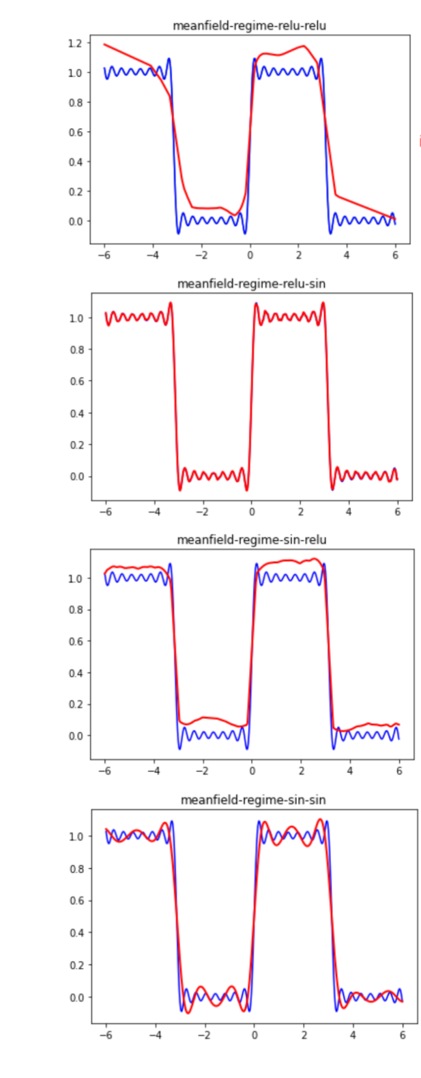
Training without NTK weight initialization
Standard weight initialization.
ReLU + sine combination perform very well
Sine + sine was also able to achieve low training loss.
ReLU activated networks don’t perform so well

Slide 18
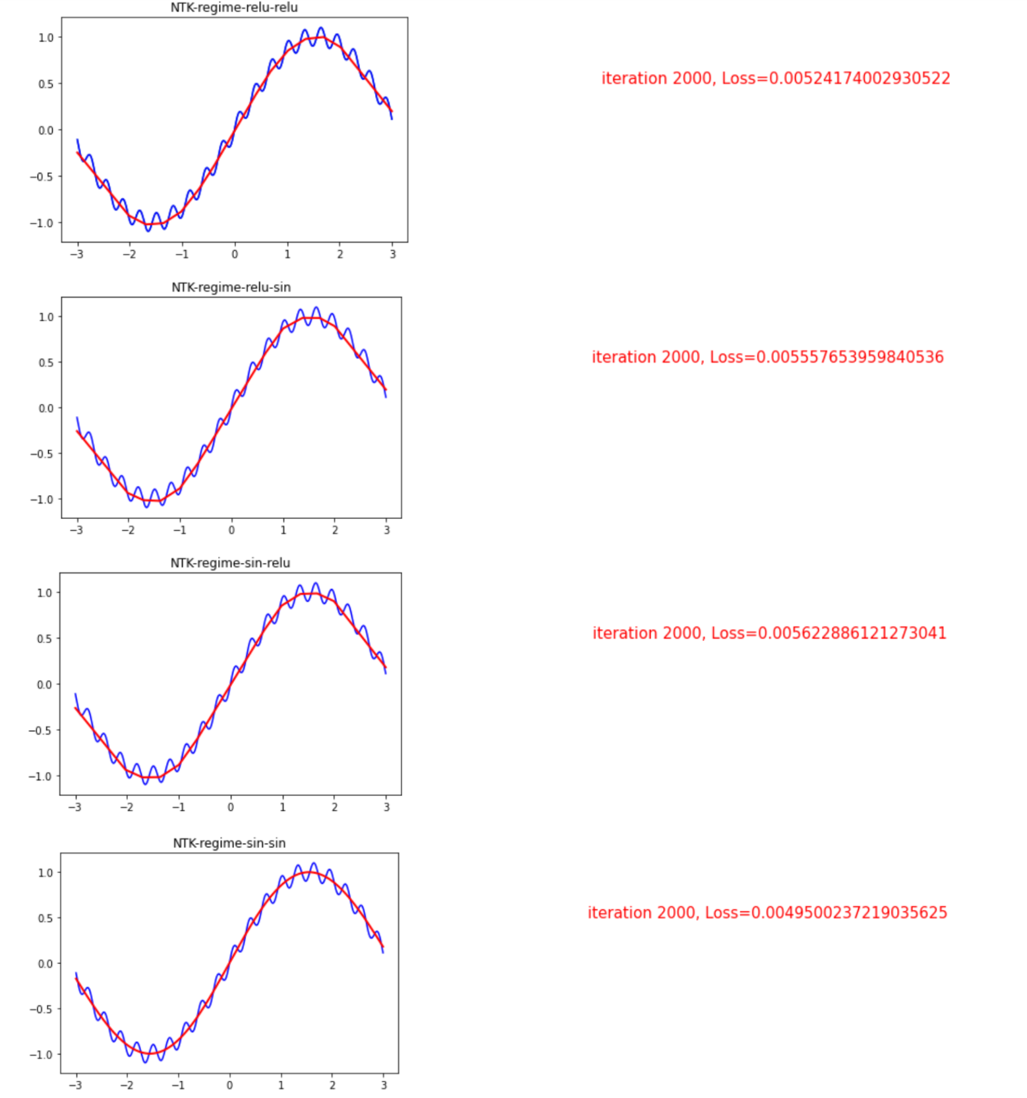
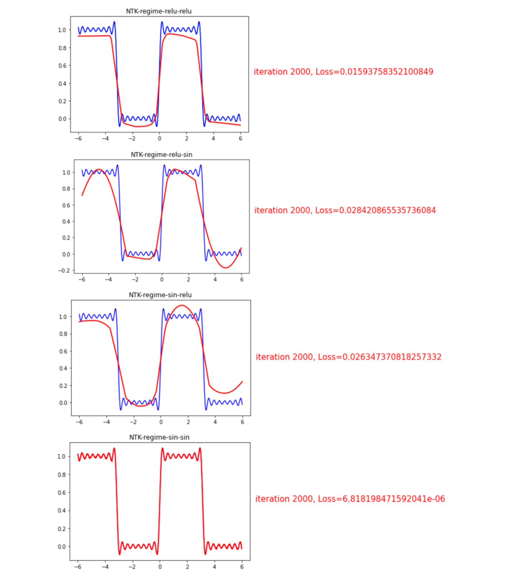
Training in NTK regime
NTK weight initialization
Lazy training
ReLU + sine isn’t able to find local minimum near weight initialization

Slide 19
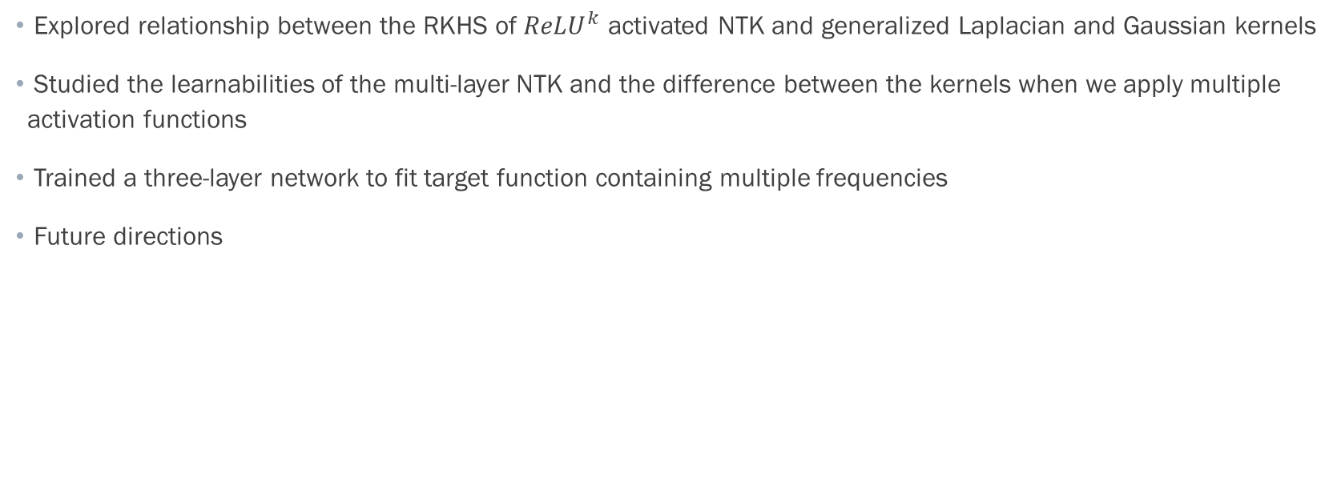
Summary
Explored relationship between the RKHS of ${ReLU}^{k}$ activated NTK and generalized Laplacian and Gaussian kernels
Studied the learnabilities of the multi-layer NTK and the difference between the kernels when we apply multiple activation functions
Trained a three-layer network to fit target function containing multiple frequencies
Future directions

Slide 20
References
[1] Bietti, Alberto, and Julien Mairal. "On the inductive bias of neural tangent kernels". arXiv preprint arXiv:1905.12173 (2019)
[2] Tancik, Matthew, et al. "Fourier features let networks learn high frequency functions in low dimensional domains." arXiv preprint arXiv:2006.10739 (2020).
[3] IBM Cloud Education. “What Are Neural Networks?” IBM, www.ibm.com/cloud/learn/neural-networks.
[4] Cao, Yuan, et al. "Towards understanding the spectral bias of deep learning." arXiv preprint arXiv:1912.01198 (2019).

